Slide 1
Power Semiconductor Devices and its Applications

Slide 2
Transistor as Switch :
Transistor switches can be used to switch a low voltage DC device (e.g. LED’s) ON or OFF by using a transistor in its saturated or cut-off state
When used as an AC signal amplifier, the transistors Base biasing voltage is applied in such a way that it always operates within its “active” region, that is the linear part of the output characteristics curves are used. However, both the NPN & PNP type bipolar transistors can be made to operate as “ON/OFF” type solid state switch by biasing the transistors Base terminal differently operating the transistor as a switch.
Solid state switches are one of the main applications for the use of transistor to switch a DC output “ON” or “OFF”. Some output devices, such as LED’s only require a few milliamps at logic level DC voltages and can therefore be driven directly by the output of a logic gate. However, high power devices such as motors, solenoids or lamps, often require more power than that supplied by an ordinary logic gate so transistor switches are used.
If the circuit uses the Bipolar Transistor as a Switch, then the biasing of the transistor, either NPN or PNP is arranged to operate the transistor at both sides of the ” I-V ” characteristics curves.
The areas of operation for a transistor switch are known as the Saturation Region and the Cut-off Region. This means then that we can ignore the operating Q-point biasing and voltage divider circuitry required for amplification, and use the transistor as a switch by driving it back and forth between its “fully-OFF” (cut-off) and “fully-ON” (saturation) regions.

Slide 3
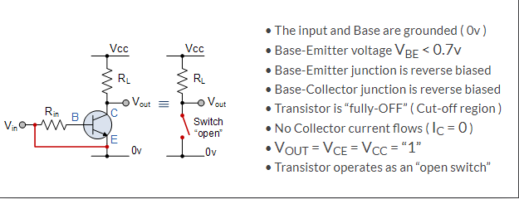
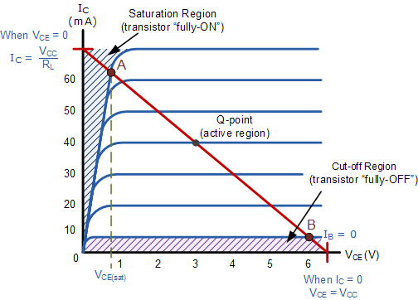
Cut-off Region :
Here the operating conditions of the transistor are zero input base current ( I_{B} ), zero output collector current ( I_{C} ) and maximum collector voltage ( V_{CE} ) which results in a large depletion layer and no current flowing through the device. Therefore the transistor is switched “Fully-OFF”.
Then we can define the “cut-off region” or “OFF mode” when using a bipolar transistor as a switch as being, both junctions reverse biased, V_{B} < 0.7v and I_{C} = 0. For a PNP transistor, the Emitter potential must be negative with respect to the Base.

Slide 4
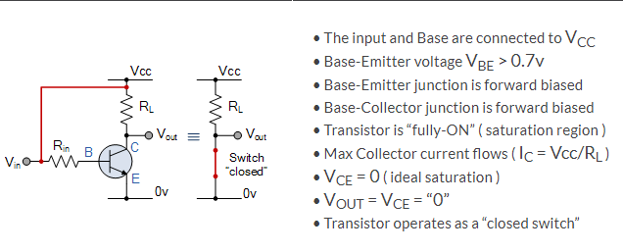
2. Saturation Region :
Here the transistor will be biased so that the maximum amount of base current is applied, resulting in maximum collector current resulting in the minimum collector emitter voltage drop which results in the depletion layer being as small as possible and maximum current flowing through the transistor. Therefore the transistor is switched “Fully-ON”.
Then we can define the “saturation region” or “ON mode” when using a bipolar transistor as a switch as being, both junctions forward biased, V_{B} > 0.7v and I_{C} = Maximum. For a PNP transistor, the Emitter potential must be positive with respect to the Base.

Slide 5
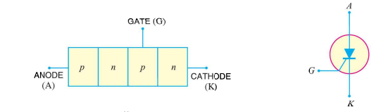
SCR ( Silicon Controlled Rectifier ) :
A silicon controlled rectifier is a semiconductor device that acts as a true electronic switch . It can change alternating current into direct current and at the same time can control the amount of power fed to load . Thus SCR combines the features of a rectifier and transistor .
When a pn junction is added to a junction transistor , the resulting three pn junction device is called a silicon controlled rectifier . It is essentially an ordinary rectifier (pn) and a junction transistor (npn) combined in one unit to form pnpn device . Three terminals are taken : one from the outer p-type material called anode A , second from the outer n-type material called cathode K and the third from the base of transistor section and is called gate G. In the normal operating conditions of SCR, anode is held at high positive potential w.r.t cathode and gate at small positive potential w.r.t. cathode.

Slide 6
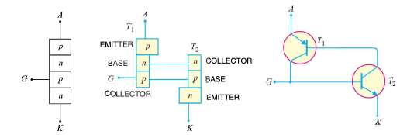
Equivalent Circuit of SCR :

Slide 7
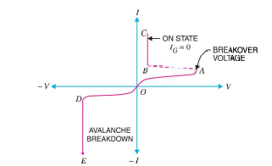
V-I Characteristics of SCR :

Slide 8
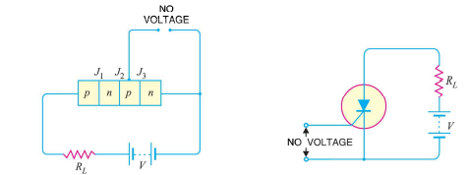
Working of SCR :
i. When Gate is open :
When no voltage is applied to the gate under this condition junction J2 is reverse biased while junctions J1 and J3 are forward biased . Hence the situation in the junctions J1 and J3 is just as in a npn transistor with base open. No current flows through the load RL and SCR is cut off. However if applied voltage is gradually increased . A stage is reached when reverse biased junction J2 breaks down. The SCR now conducts heavily and is said to be in the ON state. The applied voltage at which SCR conducts heavily without gate voltage is called Breakover voltage.

Slide 9
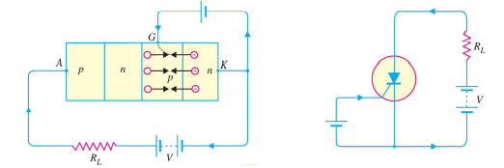
ii. When gate is positive w.r.t. cathode :
The SCR can be made to conduct heavily at smaller applied voltage by applying small positive potential to the gate . Now junction J3 is forward biased and junction J2 is reverse biased. The electrons from n-type material start moving across junction J3 towards left whereas holes from p-type towards the right . Consequently , the electrons from junction J3 are attracted across junction J2 and gate current starts flowing . As soon as the gate current flows, anode current increase. The increased anode current in turn makes more electrons available at junction J2 . This process continues and in an extremely small time , junction J2 breaks down and the SCR starts conducting heavily. Once SCR starts conducting the gate loses all control. Even if gate voltage is removed , the anode current does not decrease at all . The only way to stop conduction is to reduce the applied voltage to zero.

Slide 10
Applications of SCR :
SCRs are mainly used in devices where the control of high power, possibly coupled with high voltage, is demanded.
Their operation makes them suitable for use in medium- to high-voltage AC power control applications, such as lamp dimming, power regulators and motor control.
SCRs and similar devices are used for rectification of high-power AC in high-voltage dc power transmission.

Slide 11
TRIAC :
The major drawback of an SCR is that it can conduct current in one direction only. Therefore, an SCR can only control d.c. power or forward biased half-cycles of a.c. in a load. However, in an a.c.system, it is often desirable and necessary to exercise control over both positive and negative half-cycles. For this purpose, a semiconductor device called triac is used.
A triac is a three-terminal semiconductor switching device which can control alternating current in a load.
Triac is an abbreviation for triode a.c. switch. ‘Tri’– indicates that the device has three terminals and ‘ac’ means that the device controls alternating current or can conduct current in either direction.
Since a triac can control conduction of both positive and negative half-cycles of a.c. supply, it is sometimes called a bidirectional semi-conductor triode switch.

Slide 12
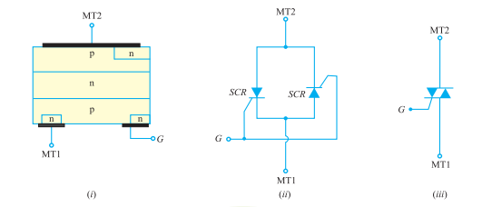
Construction :
(i) shows the basic structure of a triac. As we shall see, a triac is equivalent to two separate SCRs connected in inverse parallel (i.e. anode of each connected to the cathode of the other) with gates commoned as shown
(ii) Therefore, a triac acts like a bidirectional switch i.e. it can conduct current in either direction. This is unlike an SCR which can conduct current only in onedirection.
(iii) shows the schematic symbol of a triac. The symbol consists of two paralleldiodes connected in opposite directions with a single gate lead. It can be seen that even the symbol of triac indicates that it can conduct current for either polarity of the main terminals (MT1 and MT2) i.e.it can act as a bidirectional switch. The gate provides control over conduction in either direction.

Slide 13
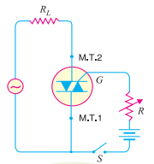
Operation :
The a.c. supply to be controlled is connected across the main terminals of triac through a load resistance RL. The gate circuit consists of battery, a current limiting resistor R and a switch S. The circuit action is as follows :
(i) With switch S open, there will be no gate current and the triac is cut off. Even with no gate current, the triac can be turned on provided the supply voltage becomes equal to the breakover voltage of triac. However, the normal way to turn on a triac is by introducing a proper gate current.
(ii) When switch S is closed, the gate current starts flowing in the gate circuit. In a similar manner to SCR, the breakover voltage of the triac can be varied by making proper gate current to flow. With a few milliamperes introduced at the gate, the triac will start conducting whether terminal MT2 is positive or negative w.r.t. MT1.
(iii) If terminal MT2 is positive w.r.t. MT1, the triac turns on and the conventional current will flow from MT2 to MT1. If the terminal MT2 is negative w.r.t. MT1, the triac is again turned on but this time the conventional current flows from MT1 to MT2.

Slide 14
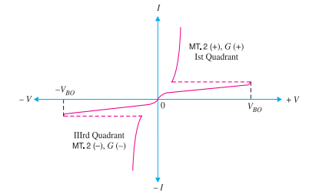
TRIAC Characteristics :
(i) The V-I characteristics for triac in the Ist and IIIrd quadrants are essentially identical to those of an SCR in the Ist quadrant.
(ii) The triac can be operated with either positive or negative gate control voltage but in normal operation usually the gate voltage is positive in quadrant I and negative in quadrant III.
(iii) The supply voltage at which the triac is turned ON depends upon the gate current. The greater the gate current, the smaller the supply voltage at which the triac is turned on. This permits to use a triac to control a.c. power in a load from zero to full power in a smooth and continuous manner with no loss in the controlling device.

Slide 15
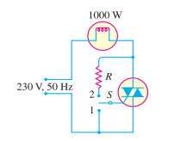
Applications of Triac :
As a high-power lamp switch :
The use of a triac as an a.c. on/off switch.When switch S is thrown to position 1, the triac is cut off and the output power of lamp is zero. But as the switch is thrown to position 2, a small gate current (a few mA) flowing through the gate turns the triac on. Consequently, the lamp is switched on to give full output of 1000 watts.

Slide 16
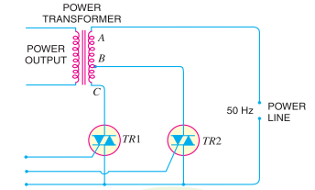
(ii) Electronic change over of transformer taps :
The circuit of electronic change over of power transformer input taps. Two triacs TR1 and TR2 are used for the purpose. When triac TR1 is turned on and TR2 is turned off, the line input is connected across the full transformer primary AC. However, if it is desired to change the tapping so that input appears across part AB of the primary, then TR2 is turned on and TR1 is turned off. The gate control signals are so controlled that both triacs are never switched on together. This avoids a dangerous short circuit on the section BC of the primary.

Slide 17
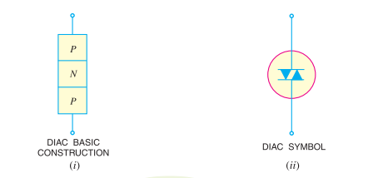
The Diac :
A diac is a two-terminal, three layer bidirectional device which can be switched from its OFF state to ON state for either polarity of applied voltage.

Slide 18
Operation :
When a positive or negative voltage is applied across the terminals of a diac, only a small leakage current IBO will flow through the device. As the applied voltage is increased, the leakage current will continue to flow until the voltage reaches the breakover voltage VBO. At this point, avalanche breakdown of the reverse-biased junction occurs and the device exhibits negative resistance i.e. current through the device increases with the decreasing values of applied voltage. The voltage across the device then drops to ‘breakback’ voltage .

Slide 19
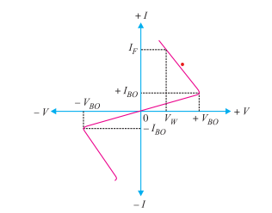
The V-I characteristics of a diac :
For applied positive voltage less than + VBO and negative voltage less than − VBO, a small leakage current (± IBO) flows through the device. Under such conditions, the diac blocks the flow of current and effectively behaves as an open circuit. The voltages + VBO and − VBO are the breakdown voltages and usually have a range of 30 to 50 volts. When the positive or negative applied voltage is equal to or greater than the breakdown voltage, diac begins to conduct and the voltage drop across it becomes a few volts. Conduction then continues until the device current drops below its holding current. Note that the breakover voltage and holding current values are identical for the forward and reverse regions of operation.

Slide 20
Applications of Diac
Lamp dimmer :
Below is a circuit that may be used for smooth control of a.c. power fed to a lamp. This permits to control the light output from the lamp. The basic control is by an RC variable gate voltage arrangement. The series R4 – C1 circuit across the triac is designed to limit the rate of voltage rise across the device during switch off.
As the input voltage increases positively or negatively, C1 andC2 charge at a rate determined primarily by R2. When the voltage across C3 exceeds the breakover voltage of the diac, the diac is fired into the conducting state. The capacitor C3 discharges through then conducting diac into the gate of the triac. Hence, the triac is turned on to pass the a.c. power to the lamp. By adjusting the value of R2, the rate of charge of capacitors and hence the point at which triac will trigger on the positive or negative half-cycle of input voltage can be controlled.

Slide 21
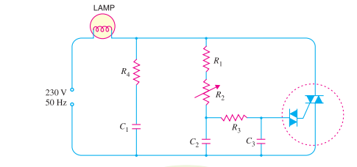
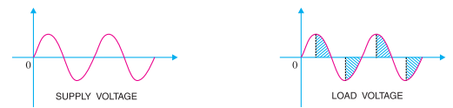
Below fig shows the waveforms of supply voltage and load voltage in the diac-triac control circuit.
The firing of triac can be controlled upto a maximum of 180°. In this way, we can provide a continuous control of load voltage from practically zero to full r.m.s. value.

Slide 22
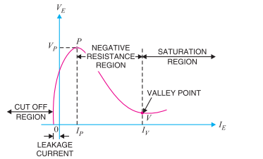
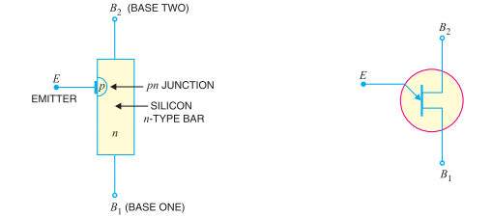
Unijunction Transistor (UJT) :
A unijunction transistor (UJT) is a three-terminal semiconductor switching device.
This device has a unique characteristic that when it is triggered, the emitter current increases regeneratively until it is limited by emitter power supply. Due to this characteristic, the unijunction transistor can be employed in a variety of applications e.g., switching, pulse generator, saw-tooth generator etc.

Slide 23
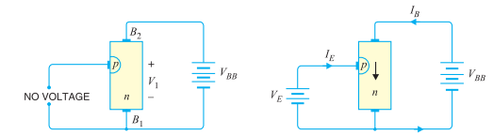
Operation :
The device has normally B2 positive w.r.t. B1.
If voltage VBB is applied between B2 and B1 with emitter open a voltage gradient is established along the n-type bar. Since the emitter is located nearer to B2, more than half of VBB appears between the emitter and B1. The voltage V1 between emitter and B1 establishes a reverse bias on the pn junction and the emitter current is cut off. Of course, a small leakage current flows from B2 to emitter due to minority carriers.
If a positive voltage is applied at the emitter, the pn junction will remain reverse biased so long as the input voltage is less than V1. If the input voltage to the emitter exceeds V1, the pn junction becomes *forward biased. Under these conditions, holes are injected from p-type material into the n-type bar. These holes are repelled by positive B2 terminal and they are attracted towards B1 terminal of the bar. This accumulation of holes in the emitter to B1 region results in the decrease of resistance in this section of the bar. The result is that internal voltage drop from emitter to B1 is decreased and hence the emitter current IE increases. As more holes are injected, a condition of saturation will eventually be reached. At this point, the emitter current is limited by emitter power supply only. The device is now in the ON state.
(iii) If a negative pulse is applied to the emitter, the pn junction is reverse biased and the emitter current is cut off. The device is then said to be in the OFF state.

Slide 24
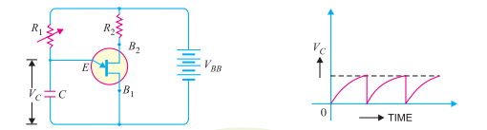
Applications of UJT
UJT relaxation oscillator :
UJT relaxation oscillator where the discharging of a capacitor through UJT can develop a saw-tooth output as shown.
When battery VBB is turned on, the capacitor C charges through resistor R1. During the charging period, the voltage across the capacitor rises in an exponential manner until it reaches the peak – point voltage. At this instant of time, the UJT switches to its low resistance conducting mode and the capacitor is discharged between E and B1. As the capacitor voltage flys back to zero, the emitter ceases to conduct and the UJT is switched off. The next cycle then begins, allowing the capacitor C to charge again. The frequency of the output saw-tooth wave can be varied by changing the value of R1 since this controls the time constant R1C of the capacitor charging circuit. The time period and hence the frequency of the saw-tooth wave can be calculated as follows. Assuming that the capacitor is initially uncharged, the voltage VC across the capacitor prior to breakdown is given by :

Slide 25
V_{C} = V_{BB} (1 − e^{− t/R}₁^{C})
where R₁C = charging time constant of resistor-capacitor circuit
t = time from the commencement of waveform.
The discharge of the capacitor occurs when VC is equal to the peak-point voltage η V_{BB} i.e. η V_{BB} = VBB (1 − e^{− t/R}₁^{C})
or η = 1 − e^{− t/R}₁^{C}
Or e^{− t/R}₁^{C} = 1 − η
or t = R₁C loge[1/(1 − η)]
∴ Time period, t = 2.3 R₁Clog₁₀ [1/(1 − η)]
Frequency of saw-tooth wave, f = 1/( t in seconds ) Hz

